Slide 1
Crop Production Analysis
By Anwesha Baidya : UMIP13240

Slide 2
Introduction
The agricultural sector, crucial to the global supply chain, is set for significant transformation due to technological advancements and the Future Internet. This analysis explores a comprehensive dataset on crop production in India, spanning several years, with the goal of predicting future trends and extracting key insights.
Utilizing a Business-to-Business collaboration platform, we aim to enhance stakeholder interactions and streamline the agri-food supply chain. Our study focuses on identifying critical indicators and metrics to optimize production strategies and improve market predictions, contributing to the sustainable growth of the agriculture sector.

Slide 3
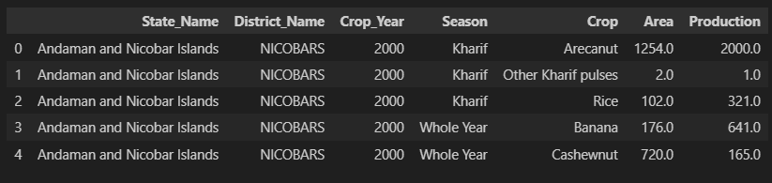
Details of Data
The data contains the huge amount of information on crop production in India
ranging from several years.
This is the layout of data:
There are a total of 124 unique Crop present in the dataset.

Slide 4
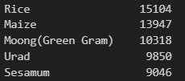
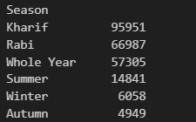
Frequencies of data
There are a total of 646 unique districts present in the dataset.
The top 5 frequency of crops present in the data are:
Frequency of crops produced in each season:

Slide 5
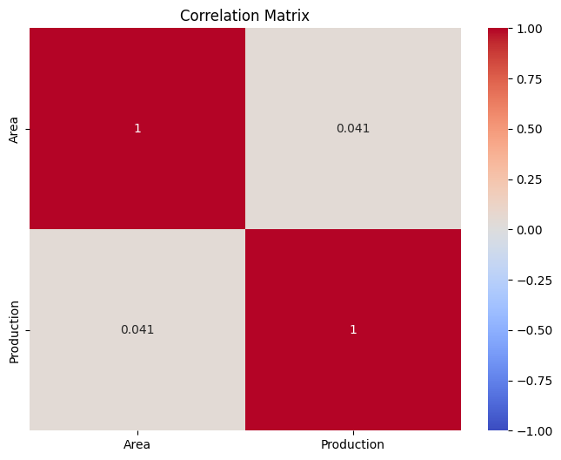
Correlation Matrix

Slide 6
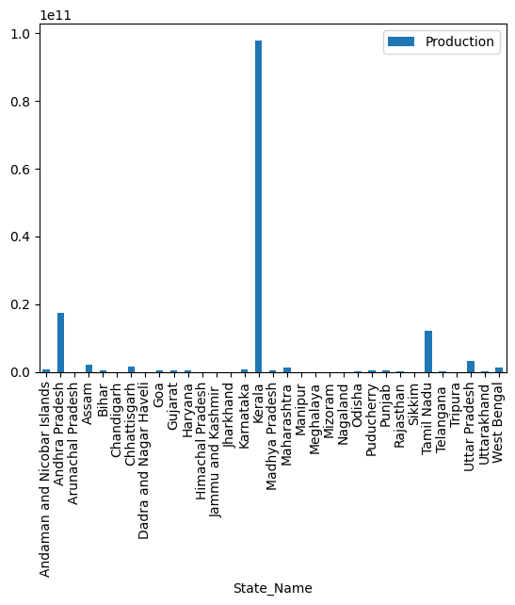
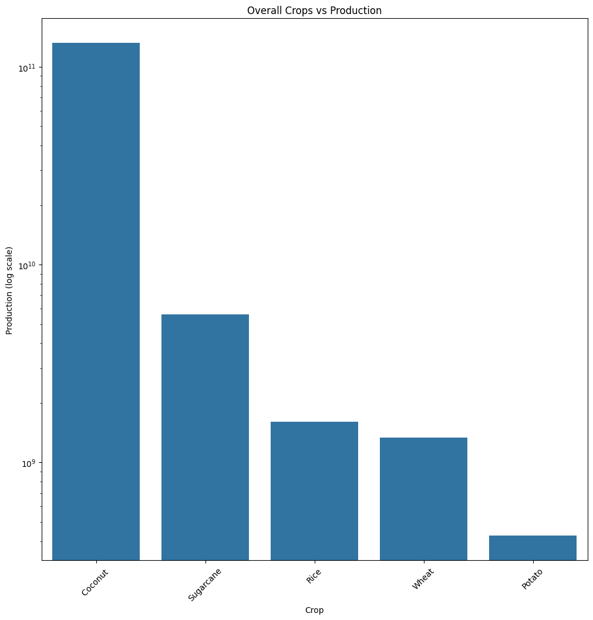
Highest production state and Highest produced crop
Kerala
Coconut

Slide 7
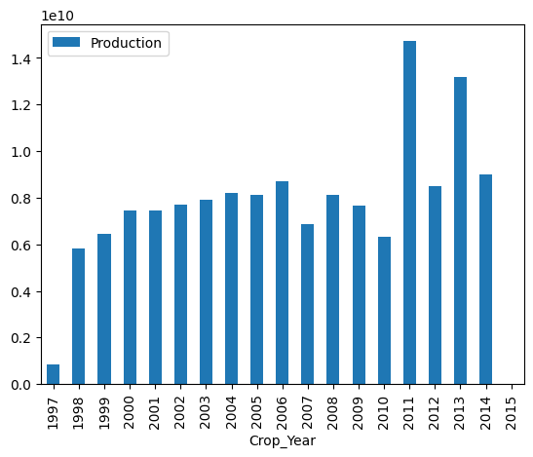
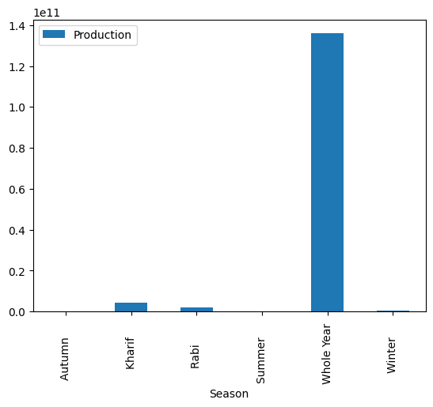
Year and Season with highest production
2011
Whole Year

Slide 8
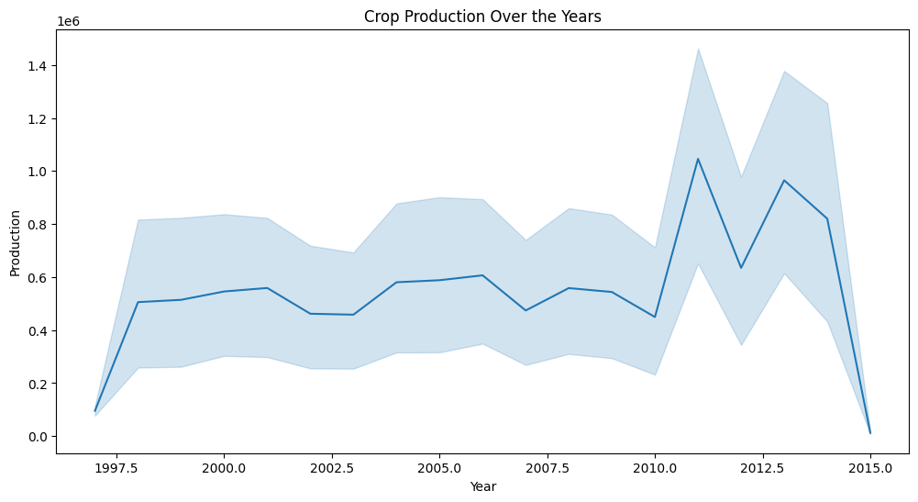
Crop Production over the years

Slide 9
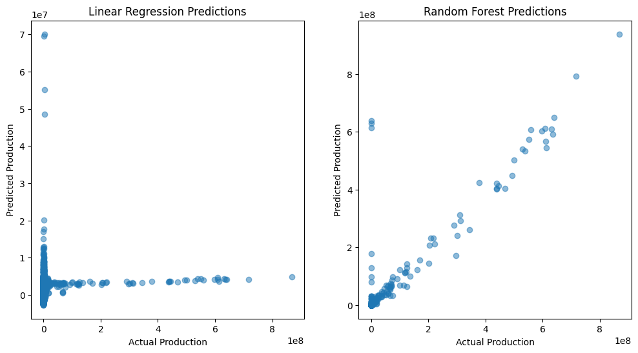
Linear Regression and Random Forest Prediction on Data

Slide 10
Thank you

